Slide 1
Looking to FOURIER: What do the trials tell us about LDL lowering and cardiovascular events?

Slide 2
NICE –CG 181 Continuum of CVD Risk and its treatment
Acute coronary syndrome (ACS)
Atorva 80mg
(+ Eze 10mg)
Post MI/Angina
Atorva 80mg
Secondary
Prevention
Other Atherosclerotic Manifestations
Atorva 80mg
Subclinical
Atherosclerosis:
Type 2 diabetes
Atorva 20+ mg
Primary Prevention
Multiple RFs
QRISK>10%
Lifestyle then Atorva 20mg
Low
Risk
Lifestyle
Courtesy of CD Furberg.; modified to include NICE CG181
Notes:
There is a continuum of cardiovascular risk
While statin therapy is the cornerstone of LDL-lowering therapy, it is also clear that a residual risk of recurrent cardiovascular events persists in high risk and very high risk patients such as those with atherosclerotic cardiovascular disease, including those with a genetic basis for the hypercholesterolaemia. In these patients, additional therapeutic options are needed. This rationale underpins the development of the PCSK9 inhibitors.

Slide 3
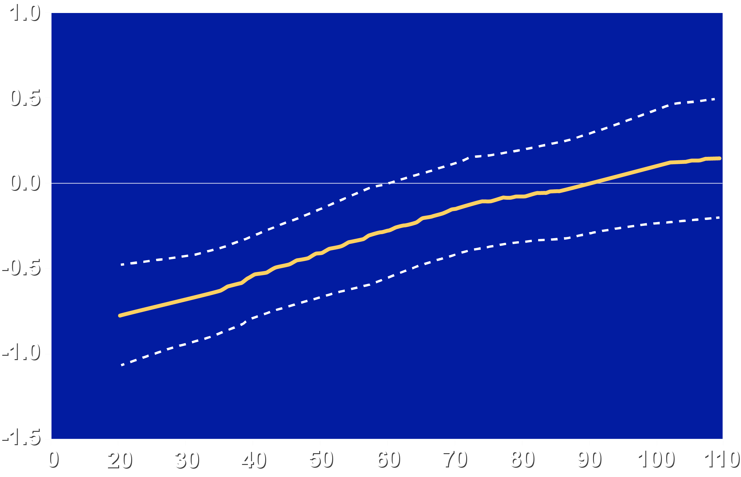
GLAGOV: Mean On-Treatment LDL-C vs. Change in PAV
Locally Weighted Polynomial Regression (LOESS) Plot with 95% confidence limits
Change Percent Atheroma Volume (%)
On-Treatment LDL-C (mg/dL)
Notes:
What is the effect of additional lowering LDL with a PCSK9 inhibitor on atheroma progression?
GLAGOV (Global Assessment of Plaque Regression with a PCSK9 Antibody as Measured by Intravascular Ultrasound) showed that treatment with the PCSK9 inhibitor evolocumab on top of statin led to further lowering of LDL cholesterol and induced plaque regression (1% reduction in percent atheroma volume, the primary endpoint) compared with stable intensive statin therapy alone. There was, however, variability in the confidence intervals for crossing from stabilisation to regression of atheroma as indicated above.
Reference
Nicholls SJ, Puri R, Anderson T et al. Effect of evolocumab on progression of coronary disease in statin-treated patients: The GLAGOV randomized clinical trial. JAMA 2016;316:2373-84.

Slide 4
IVUS studies: Change in atheroma volume vs. LDL-C
REVERSAL- P
REVERSAL- A
METEOR
GLAGOV-E
SATURN- R
Notes:
How do the GLAGOV data compare with other IVUS studies?
When data from all IVUS studies of LDL- lowering therapy are plotted, variability in response in terms of atheroma regression with statin therapy was also noted.

Slide 5
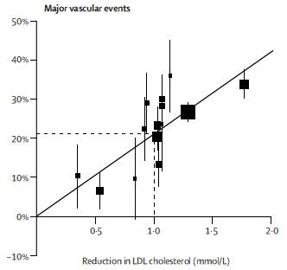
Meta-analyses of CHD vs LDL-C and Incremental effects of lipid drugs
Cholesterol Treatment Trialists; Lancet 2010; 376: 1670
Charland SL & Stanek EJ; Pharmacother 2014; 34 : 452
Notes:
What do clinical trials of LDL lowering tell us?
As shown by the Cholesterol Treatment Trialists’ Collaboration (data updated in 2016), the magnitude of LDL lowering determines the extent of cardiovascular benefit, in terms of reduction of major cardiovascular outcomes studies. Thus, intensive statin therapy, as compared with moderate-dose statin therapy, incrementally lowers LDL cholesterol levels and rates of nonfatal cardiovascular events.
References
1. Cholesterol Treatment Trialists’ (CTT) Collaboration et al. Efficacy and safety of more intensive lowering of LDL cholesterol: a meta-analysis of data from 170,000 participants in 26 randomised trials. Lancet 2010;376:1670-81.
2. Collins R, Reith C, Emberson J et al. Interpretation of the evidence for the efficacy and safety of statin therapy. Lancet 2016;388:2532-61.

Slide 6
IMPROVE –IT : Ezetimibe in statin-treated ACS
Lipids
Events
Change (%)
4.20
1.35
1.10
2.46
(1.80)
P=0.002
P=0.01
p=0.95
1.40
p=0.01
Secondary prevention; n= 18144
Cannon CP et al ; NEJM 2015; 372 : 2387
Notes:
Does the modality of LDL lowering matter?
No. The IMPROVE-IT showed that a non-statin LDL lowering therapy (ezetimibe) added to optimised statin therapy, led to additional lowering of LDL cholesterol levels (by 0.4 mmol/L over statin alone, averaged over the study) and significantly better cardiovascular outcomes (absolute risk reduction 2% versus statin alone, hazard ratio, 0.936; 95% confidence interval, 0.89 to 0.99; p=0.016).
Reference
Cannon CP, Blazing MA, Giugliano RP et al. Ezetimibe added to statin therapy after acute coronary syndromes. N Engl J Med 2015;372:2387-97.

Slide 7
Defining recommendations
Targets
Drug-based
Consistent with epidemiology
Rare in clinical trials
Traditional output
Focused on single risk factor
Set on 50th centile
Requires multiple monitoring
Consistent with trials
Exception limits defined
Common trial design
Novel output
Focused on overall risk
Centile-independent
Minimal monitoring required
Notes:
Translating to guidelines
In translating evidence from clinical trials to guideline recommendations, which is the best approach: targeting LDL cholesterol goals or cardiovascular risk? Each have their advantages and disadvantages.

